Slide 1
PROBLEM AND RECOMMENDATION -1

Slide 2
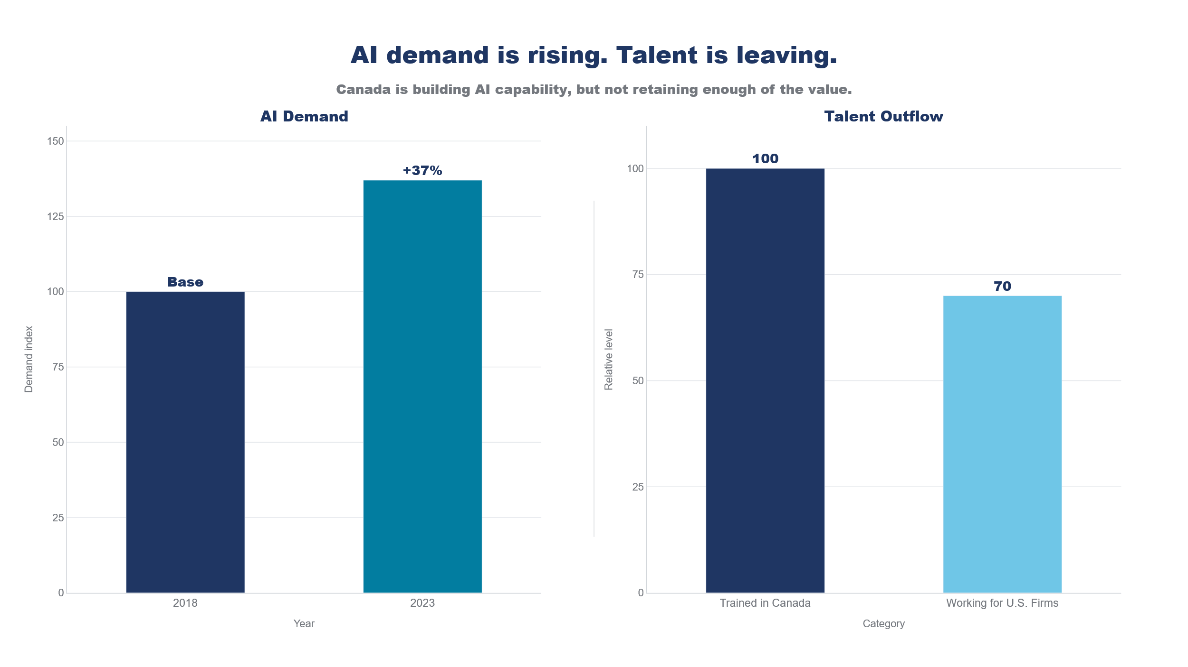
Problem 1 - Canada's AI Talent Paradox: High Acquisition, Yet Critical Outflow to US Tech Hubs
Despite successfully attracting global AI talent, Canada suffers a severe retention deficit, effectively subsidizing US innovation as top researchers migrate south for better compensation and career trajectories.
High Initial Acquisition: We successfully draw globally recognized ML researchers into Canadian institutions, , though permanent retention remains a challenge.
The 20% Attrition Reality – 1 in 5 highly skilled professionals leave within their first five years, with technical and research fields showing the weakest long-term retention.
The US Pull Factor – Severe domestic salary ceilings and limited late-stage career pathways force a rapid exodus of senior ML talent to American competitors.
Source: Vector Institute / The Conference Board of Canada (2024); Spicer, Olmstead & Goodman, Core AI skill demand in Canada: +37% (2018–2023);
Notes:
Sam
First, looking at our system's input, Canada currently operates as a high-volume global talent incubator. We successfully draw top-tier Machine Learning talent into our institutions initially, but we struggle to anchor them permanently."
"This leads to our second point: a severe retention deficit. We face a 20% attrition reality—one in five highly skilled professionals exits within their first five years, primarily in core technical fields."
"The root cause is a structural bottleneck. Severe domestic salary ceilings and limited late-stage career pathways create a massive US Pull Factor, forcing a rapid exodus of our senior ML talent to American competitors."
"In short: The charts prove that we are generating the human capital to meet our 37% demand spike, but our structural limits mean we are functionally subsidizing US tech innovation. We are building the capability, but losing the value.

Slide 3
Recommendation 1 - Build Career Moats for Talent - Sam Target: Problem 1 (Canada's AI Talent Paradox)
THE OBJECTIVE: Pivot Canada from a "global talent incubator" into a destination for top engineers by directly attacking the take-home pay gap and removing immigration friction.
Action Items:
Elite Equity Tax Exemption: Significantly lower the capital gains tax on stock options for Principal-level AI engineers. We must make building wealth in Canada mathematically competitive with Silicon Valley.
1:1 Salary Matching: If a Canadian AI firm commits to raising a top engineer’s base salary by 20%, the government matches it 1:1 through immediate, targeted R&D tax credits to shatter the compensation ceiling.
The "AI Elite" Fast-Track Visa: Implement instant, frictionless permanent residency (PR) and open work permits for top-tier global AI engineers and specialized graduates to easily anchor their lives in Canada.
The Mechanism: Execute by aggressively modernizing existing programs:
Repurpose the existing SR&ED (R&D) tax credit pools to specifically target the salary matching.
Reallocate portions of the $200M AI Adoption Fund (Budget 2024) to directly subsidize human capital
Execution & Accountability :
Agile Rollout: Bypass slow government approvals. Pre-qualify high-growth AI companies to instantly issue these tax and visa benefits to their top hires.
The Metric: Subsidized companies MUST maintain core AI team attrition below 15% over a 24- 36month window.
The Clawback: Annual independent audits. If a subsidized engineer relocates to the US, it triggers immediate funding suspension and full clawbacks of the tax subsidy.
Notes:
"To fix this paradox, we must pivot Canada from being just an incubator to a final destination. Recommendation 1 is to build Career Moats for our talent."
"The objective is direct: attack the take-home pay gap and remove the remaining immigration friction. We achieve this through three action items: an Elite Equity Tax Exemption to mathematically align wealth-building with Silicon Valley, a 1:1 Salary Matching mechanism to shatter the compensation ceiling, and an 'AI Elite' Fast-Track Visa for frictionless permanent residency."
"How do we pay for this without printing new money? Simple. Canada already has a massive R&D tax rebate program called SR&ED. Right now, it's slow and broad. We are simply taking a slice of that existing pie, and fast-tracking it to directly match the salaries of elite AI engineers. We are using money that’s already on the table, just spending it smarter to keep our best brains at home."
"Finally, execution requires strict accountability. Subsidized companies MUST maintain core attrition below 15%. If a subsidized engineer relocates to the US, it triggers immediate funding suspension and full clawbacks of the tax subsidy. We subsidize retention, not departure."

Slide 4
PROBLEM AND RECOMMENDATION -2

Slide 5
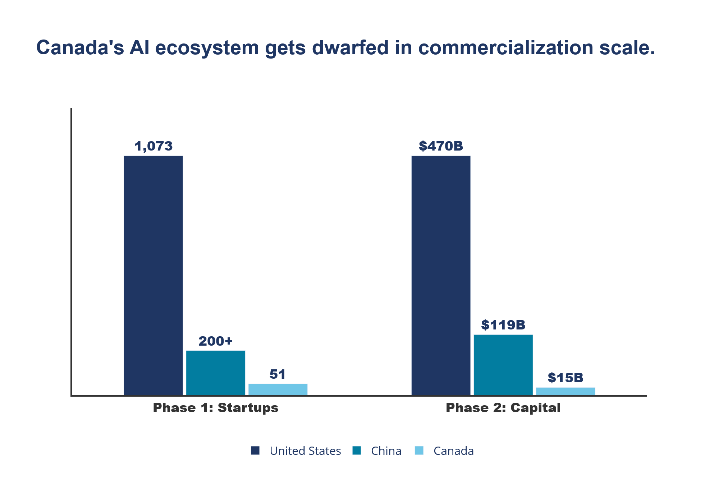
Problem 2 - The Commercialization "Valley of Death” Canada’s AI weakness is not research creation, but domestic commercialization and scale
Canada has built world-class AI talent and research institutions, but it has not built equally strong conditions to scale AI firms at home. As a result, the country generates upstream innovation but captures too little downstream economic value.
Commercialization pathways remain weak. Many firms can prove technical feasibility, but struggle to convert pilots into repeatable customer adoption and revenue growth.
Compute access remains constrained. Domestic firms face limited access to the infrastructure needed to train, deploy, and iterate AI systems at scale.
Compute access remains constrained. Domestic firms face limited access to the infrastructure needed to train, deploy, and iterate AI systems at scale.
Source: Stanford HAI AI Index Report 2024 | Vector Institute Analysis (Cumulative Capital Estimates 2024-2026)
Notes:
Sam
"The core thesis here is a structural mismatch. Canada generates world-class upstream innovation through our research institutions, but we completely fail to capture the downstream economic value."
"This failure is driven by two distinct bottlenecks. First, weak commercialization pathways. Our firms are excellent at proving technical feasibility in isolated pilots, but struggle to convert them into repeatable revenue. Second, severe infrastructure constraints. Domestic firms simply lack access to the large-scale compute power needed to deploy and iterate AI models."
"Please direct your attention to the chart on the right, which starkly illustrates this gap."
"We are not just lagging; we are being dwarfed. Look at Phase 2, the capital phase. Canada’s AI ecosystem captures roughly $15 Billion. Contrast this with the United States at a massive $470 Billion. The magnitude of this gap makes domestic scaling mathematically nearly impossible under current conditions."
"In short: We are successfully engineering the science, but failing to engineer the business. Without domestic compute and scaling capital, our innovations are born here, but cross the border to grow up."

Slide 6
Recommendation 2 - Build the Conditions to Scale AI in Canada Target: Problem 2 (The Commercialization "Valley of Death”)
THE OBJECTIVE: Turn AI research into AI companies. Shift focus from upstream creation to capturing downstream economic value via domestic scaling.
Action Items:
Expand Compute: Provide local builders prioritized, affordable access to high-performance infrastructure.
Accelerate Adoption: Use procurement and SME programs to convert AI pilots into repeatable revenue.
Strengthen Scale-up: Retain growth-stage firms through better enterprise access and later-stage capital.
The Mechanism: Repurpose Budget 2024 capital directly into commercialization, bypassing slow grants:
Compute ($2B Fund): Deploy as direct utilization subsidies for domestic firms, rather than building state-owned infrastructure.
Adoption ($200M RDA Fund): Ring-fence strictly for B2B procurement matching—paying traditional industries to buy local AI.
Execution & Accountability:
The Metric: Government "buy and adopt" programs MUST enforce a conversion mandate: >50% of subsidized pilots must become commercial contracts within 18 months.
The Clawback: Annual audits. Relocating HQ or core IP out of Canada triggers immediate and full funding clawbacks.
Notes:
"To bridge this 'Valley of Death' and stop exporting our potential, we move to Recommendation 2: Building the conditions to actually scale AI in Canada."
"The core objective is a necessary paradigm shift. We must turn AI research into AI companies, pivoting our focus from upstream creation to capturing downstream economic value."
"We attack this through three action items: Expanding affordable compute access for local builders, accelerating domestic adoption to convert pilots into repeatable revenue, and strengthening later-stage capital to retain growth-stage firms."
"The execution mechanism is agile. We bypass slow government grants and repurpose existing Budget 2024 capital. For the $2 Billion Compute Fund, we deploy it as direct utilization subsidies for domestic firms—we should not be wasting time building state-owned infrastructure. For the $200 Million Adoption Fund, we ring-fence it strictly for B2B procurement matching. We are essentially incentivizing our traditional industries to buy local AI."
"Finally, we enforce strict accountability. Government programs must hit a hard metric: over 50% of subsidized pilots must convert into commercial contracts within 18 months. And the ultimate safeguard: if a firm relocates its HQ or core IP out of Canada, it triggers immediate and full funding clawbacks. We invest in domestic scaling, not foreign extraction."

Slide 7
REFERENCES
https://ised-isde.canada.ca/site/ised/en/canadian-sovereign-ai-compute-strategy
https://ised-isde.canada.ca/site/ised/en/sme-ai-adoption-blueprint

